Slide 1
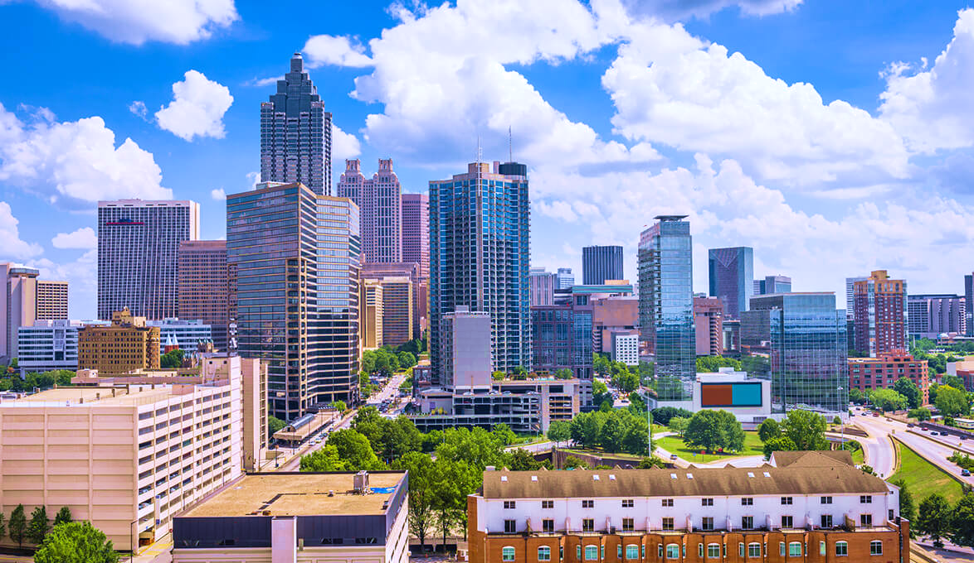

We are
Hiring
ALSER Lab is moving to the beautiful city of Atlanta, GA

Slide 2
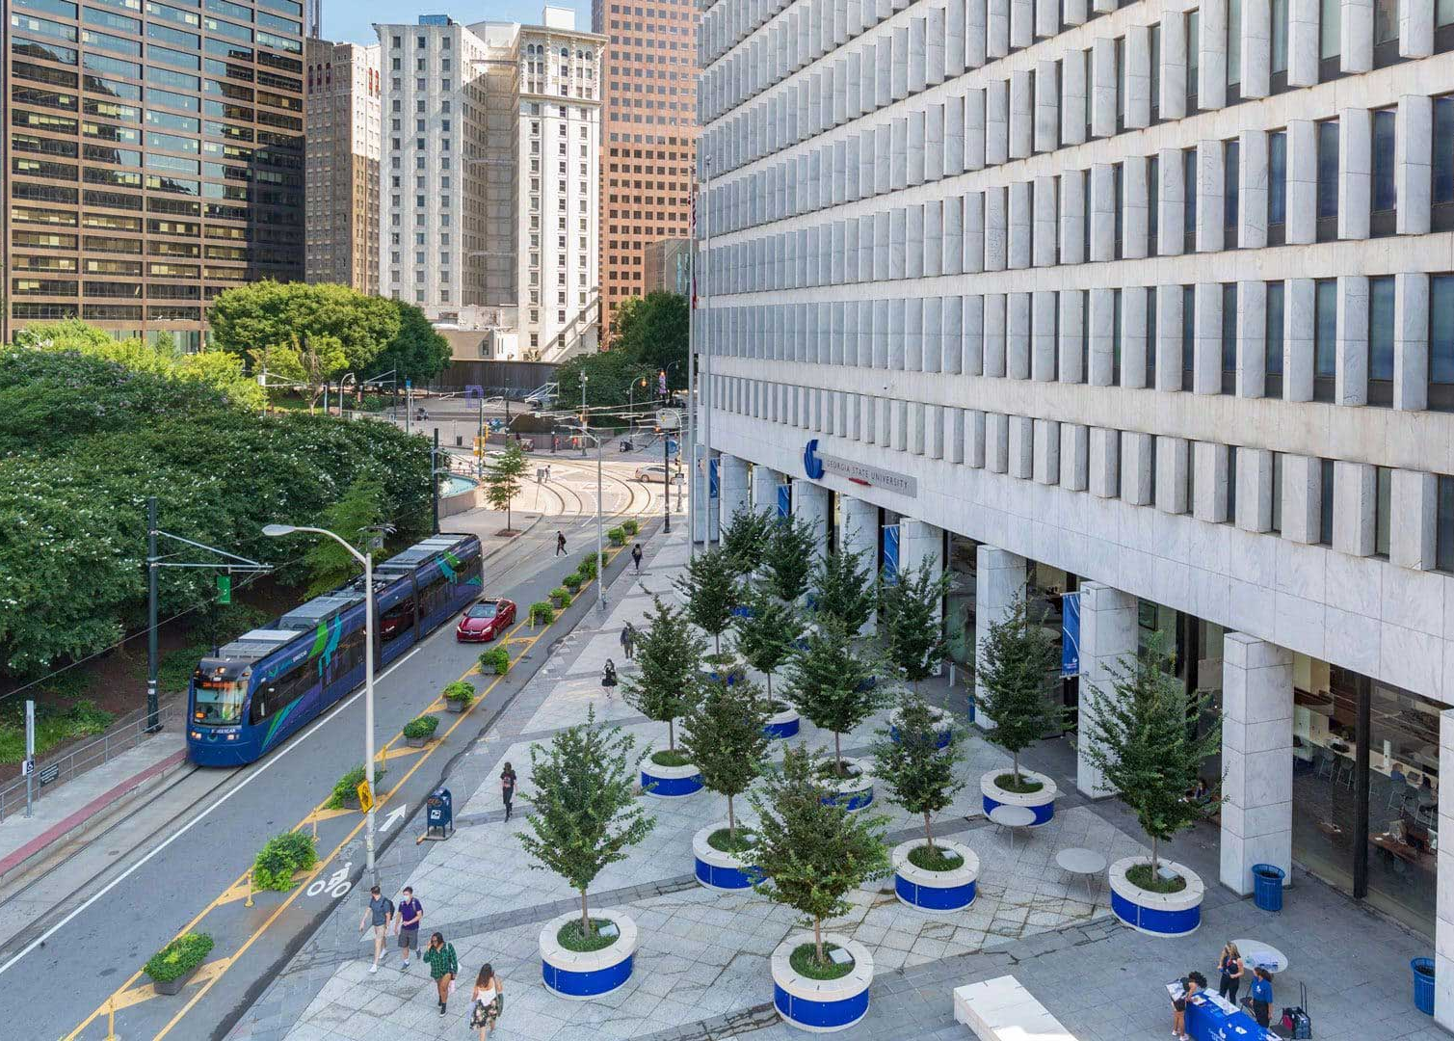

We are
Hiring
We are now part of the CS department, Georgia State University

Slide 3
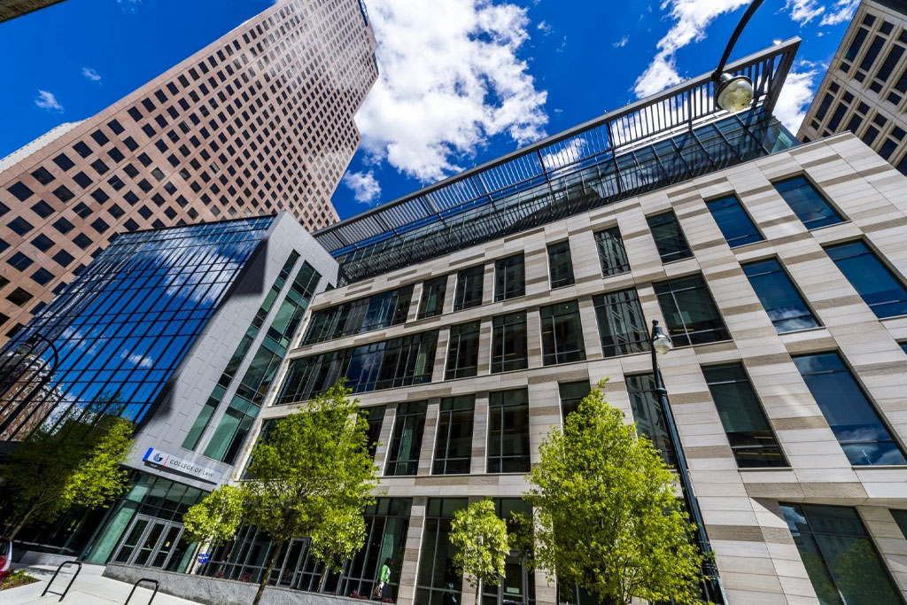
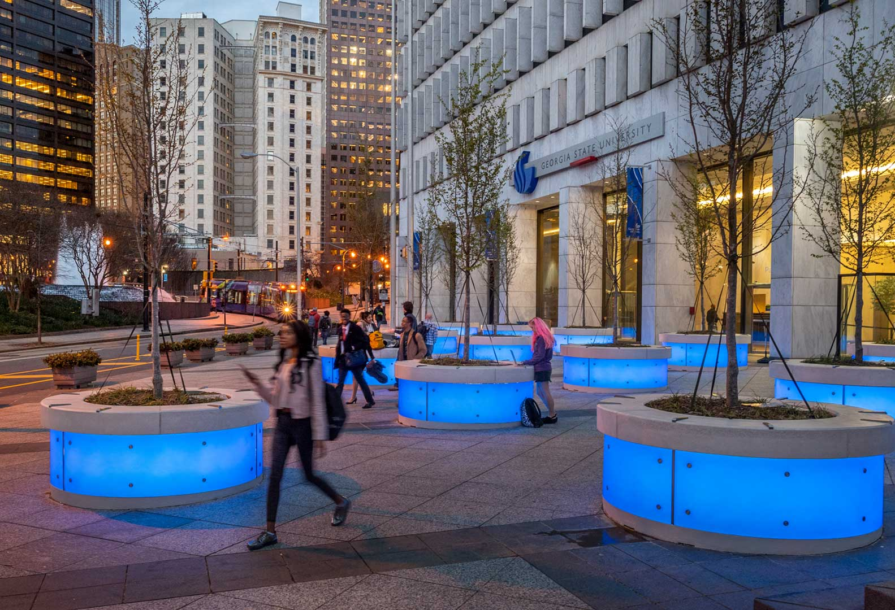


2
#
in the U.S. for Teaching

Slide 4
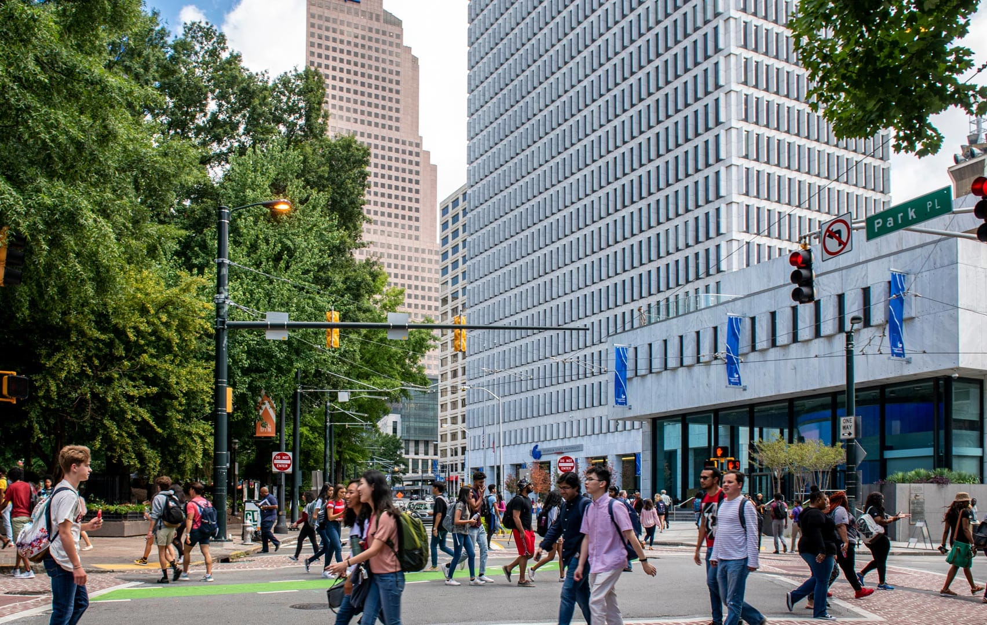
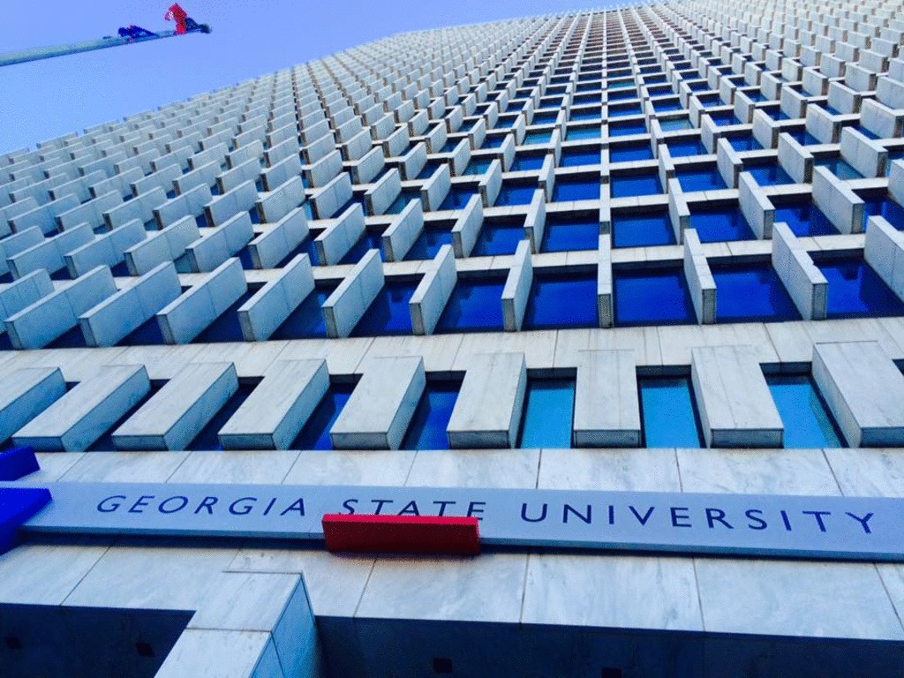

2
#
in the U.S. for Innovation

Slide 5
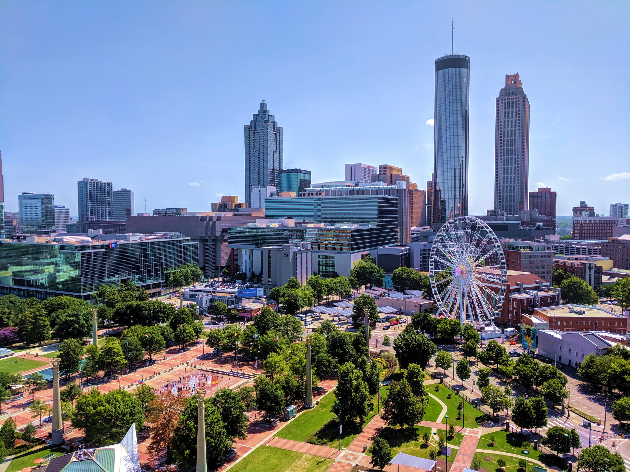

We are
Hiring
ALSER Lab is moving to the beautiful city of Atlanta, GA

Slide 6


